Slide 1

Online gym management system
FITNESS
FITNESS
FITNESS
FITNESS
FITNESS
FITNESS
FITNESS
Presented By:
Ramesh Lodangi
Spandana Thallapelly
Ketan sondarava
Ravi Ranjan kumar
Under the guidance of:
Suramya biswas

Slide 2

AGENDA
Project statement and outcome
Technologies and tools
Modules to be implemented
Conclusion and future enhancement
AGENDA
AGENDA

Slide 3
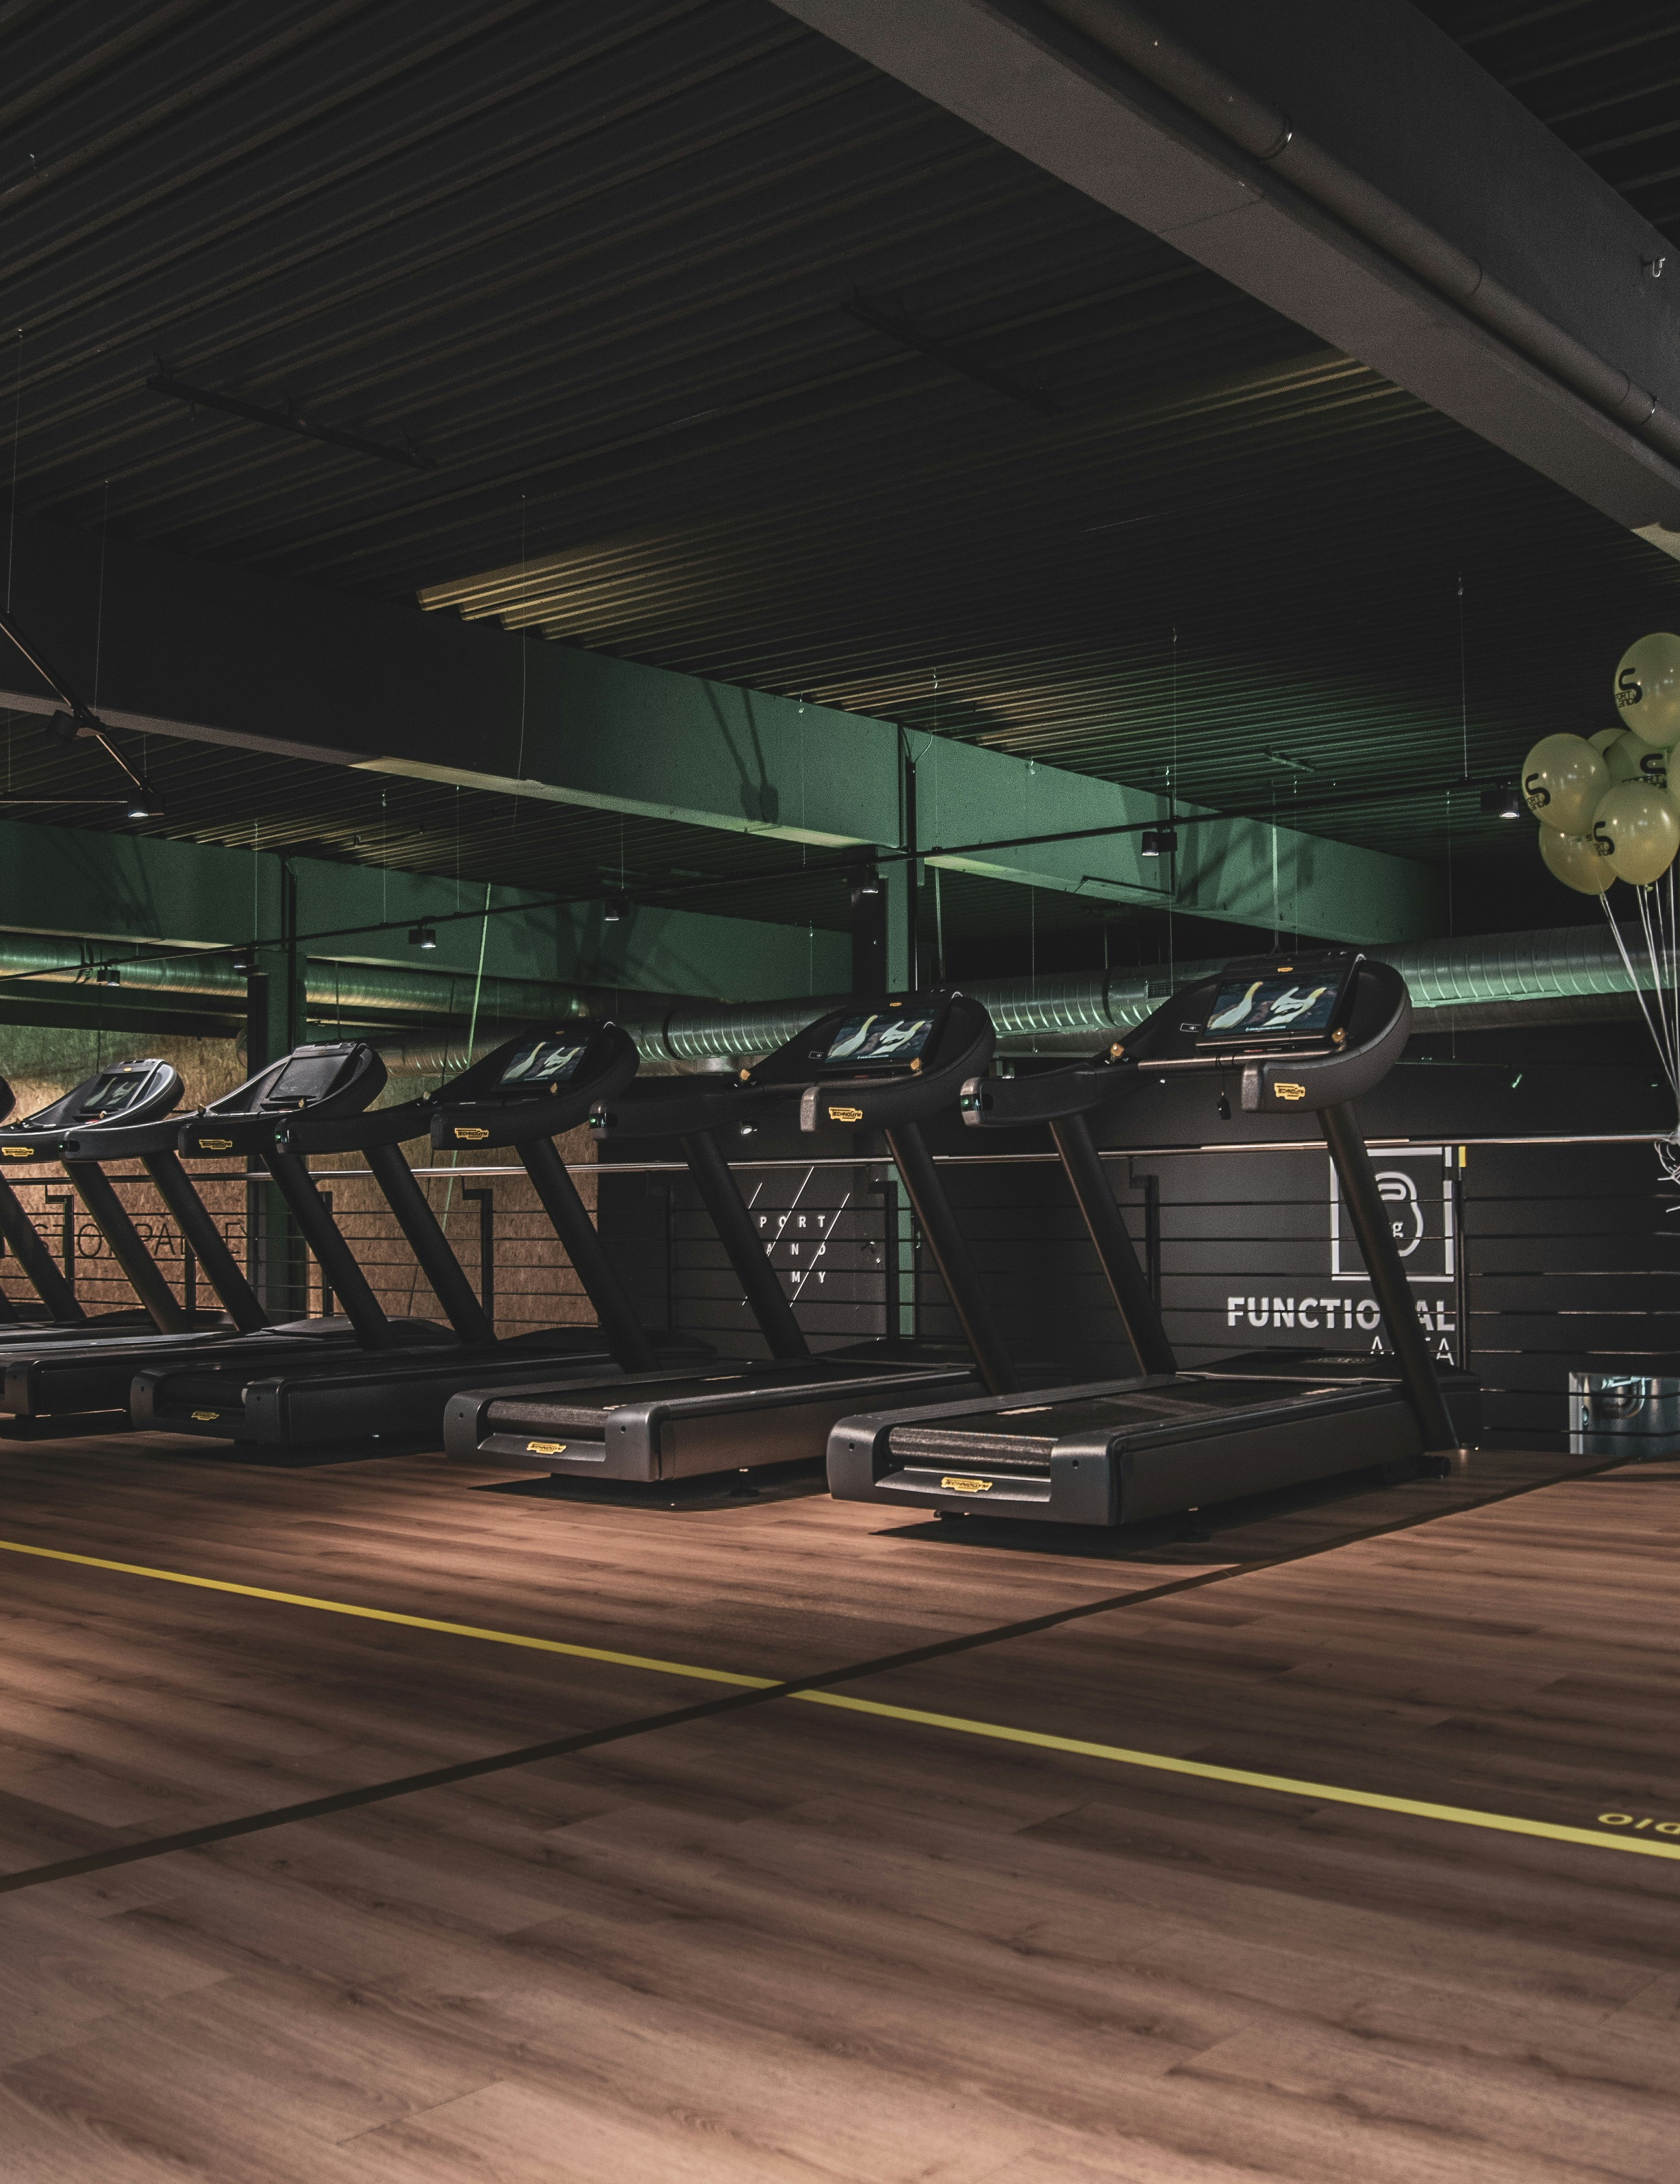
Project statement
Our project aims to develop a user-friendly web application that facilitates the Gym Management Software where there is a gym and health club membership management system. To streamline operations, boost customer satisfaction, and provide management with analytical insights through extensive reporting capabilities.
Our Gym Management Software is a complete gym and recreation facility system program which looks after all of your members, memberships and activities. It is designed for gyms, recreation center, and health clubs.
outcome

Slide 4

Technologies and tools
Front-end : Java server pages(jsp), Cascading style sheets(css) and Java script
Back-end: Java, Spring Boot
(Spring MVC, Spring Data JPA and
Spring Security)
Database: mysql
Build tool: Maven
Web server: tomcat
environment: Eclipse ide
5

Slide 5
Modules to be implemented
User Authentication and Registration
Gym Slot Scheduling Interface
Slot availability Management
Slot Booking Information Management
FeedBack Management
Admin Dashboard

Slide 6
Module 1: User Authentication and Registration ( for both ADMIN and CUSTOMER)
Implement user registration functionality.
Develop user login mechanism.
Module 2: Gym Slot Scheduling Interface
Design database schema for storing gym slot availability information.
Develop an interface for gym slot to set their availability.
Implement backend functionality to manage and update slot availability.

Slide 7
Module 3: Slot availability Management
Design and develop the interface for slot scheduling.
Implement functionality for users to select slot, preferred time slots.
Integrate the scheduling interface with the backend for storing time slot details.
Module 4: Slot Booking Information Management
Design database schema for storing slot details.
Implement backend functionality for scheduling slot and preventing conflicts.
Develop an interface for Organizer and Customer to view and manage slot.

Slide 8
Module 5: Customer Feedback Information Management
Design database schema for storing customer information securely.
Develop functionality for customer to provide and update their information.
Implement backend logic for accessing and managing customer information securely.
Module 6: Admin Dashboard (access to all operations)
Design the layout and functionality of the admin dashboard.
Implement user management features for admin to add, edit, and delete users.
Develop modules for managing gym items, slot, and customer information.

Slide 9

conclusion
Key Insights: Summarizing the most critical findings and takeaways from the project development process, highlighting successes and learning experiences.
Benefits of Implementation: Recapping the overall advantages brought by the system, from customer satisfaction to operational efficiency in the gym management process.
Opportunities for Future Improvements: Identifying areas where ongoing developments can be made post-launch, ensuring the system continuously meets the evolving needs of users.
And
Future enhancement

Slide 10

THANK YOU
THANK
YOU
THANK
YOU
THANK
YOU
THANK
For all your attention.

